Slide 1

PART-V-Structured Analysis
Software Engineering (SE) → CSEN3202 – CSE/BTech/6th Semester → Module-I → Prepared by : Nilina Bera, CSE, HITK

Slide 2
What is structured analysis?
Structured analysis is a software engineering technique that uses graphical diagrams to develop and portray system specifications that are easily understood by users.
These diagrams describe the steps that need to occur and the data required to meet the design function of a particular software
It focuses on specifying what the system or application is required to do.
Elements of structured analysis
Context Diagrams (CD)
Data Flow Diagrams (DFD)
Data Dictionary: definitions of elements in the system
Decision Tree, Decision Table
Nilina Bera

Slide 3
Creating the Context Diagram
The context diagram is the highest level in a data flow diagram and contains only one process, representing the entire system. The process is given the number zero. All external entities are shown on the context diagram, as well as major data flow to and from them. The diagram does not contain any data stores and is fairly simple to create, once the external entities and the data flow to and from them are known to analysts.
WHAT IS A CONTEXT DIAGRAM?
A context diagram shows:
  Data input to the system,
  Output data generated by the system,
  External entities.
Context diagram captures:
  Various entities external to the system and interacting with it.
  Data flow occurring between the system and the external entities.
  Establishes the context of the system, i.e. representing Data sources and Data sinks
Nilina Bera

Slide 4
Context Diagram (CD)
The Context Diagram shows the system under consideration as a single high-level process and then shows the relationship that the system has with other external entities (systems, organizational groups, external data stores, etc.).
Another name for a Context Diagram is a Context-Level Data-Flow Diagram or a Level-0 Data Flow Diagram.
A Data-Flow Diagram (DFD) is a graphical visualization of the movement of data through an information system. A DFD is process centric and depicts 4 main components.
Nilina Bera

Slide 5

Nilina Bera

Slide 6
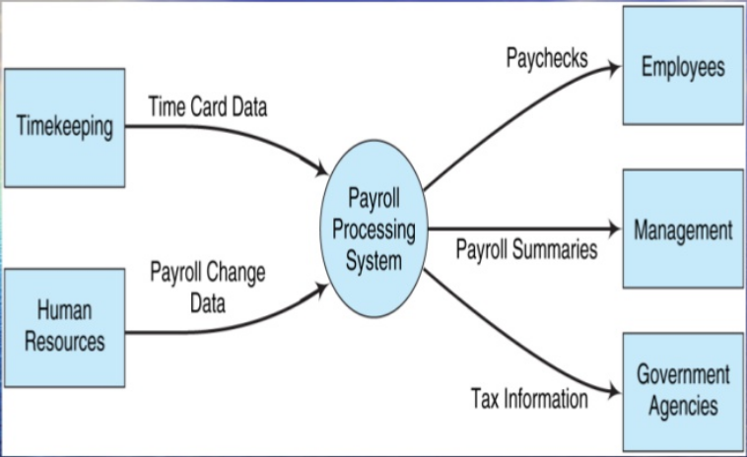
Context Diagram (CD)
Nilina Bera

Slide 7
DFD - data flow diagram - used to chart the input, processes, and output of the business's functions in a structured graphical form
data dictionary - developed from the DFDs; lists all of the data items used in the system along with their specifications
Nilina Bera

Slide 8
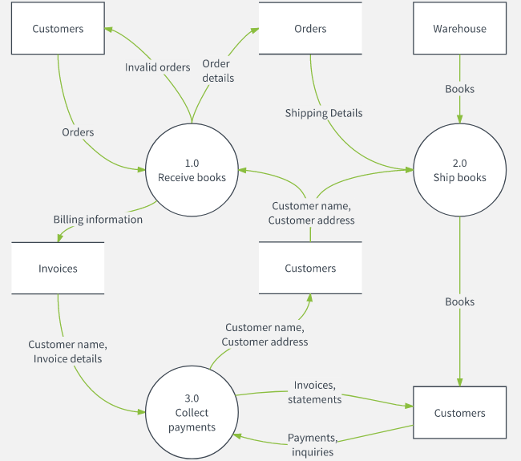
Nilina Bera

Slide 9
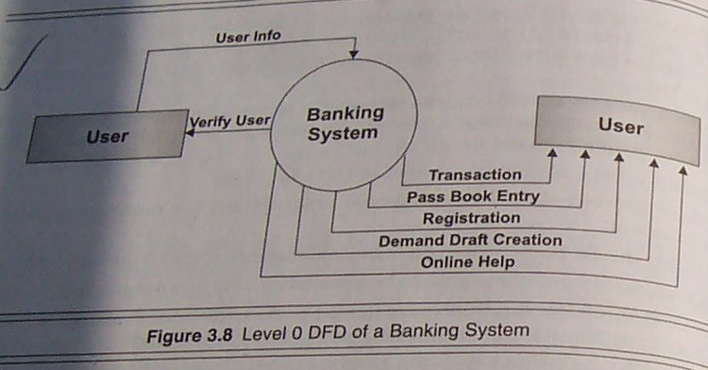
The context diagram is also called as the level 0 DFD
Nilina Bera

Slide 10
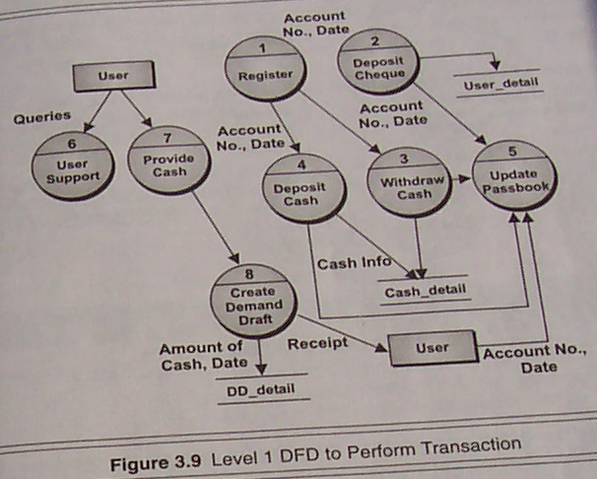
Nilina Bera

Slide 11
Level 1 DFD- HOW IT WORKS TO PERFORM TRANSACTION IN A BANKING SYSTEM WITH REGISTERED CUSTOMERS?
Theoretical Concept: Level 1 DFD Examine the SRS document:
  Represent each high-level function as a bubble.
  Represent data input to every high-level function.
  Represent data output from every high-level function.
Nilina Bera

Slide 12
Level 1 DFD- HOW IT WORKS TO PERFORM TRANSACTION IN A BANKING SYSTEM WITH REGISTERED CUSTOMERS?
Practical Process – How to utilize the bubbles or processes and how they are tied together?
1. Level-0 DFD of a Banking System ➔ Level-1 DFD to Perform Transaction ➔ The Level 0 DFD is expanded to Level 1 DFD.
2. In Level 1 DFD, the “User” entity is related to several processes in the Bank, which include
“Register”
“User Support”
“Provide Cash”
“Deposit Cheque”
“Deposit Cash”
“Withdraw Cash”
“Update Passbook”
“Create Demand Draft”
Nilina Bera

Slide 13
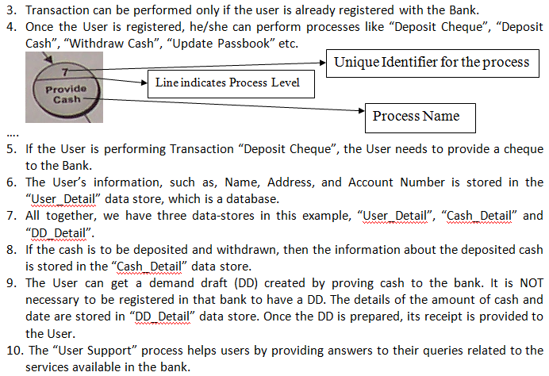
Nilina Bera

Slide 14
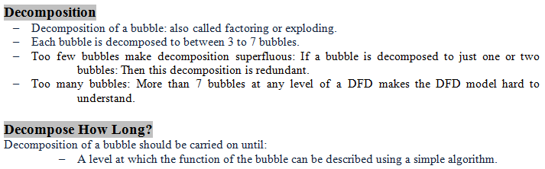
Nilina Bera

Slide 15
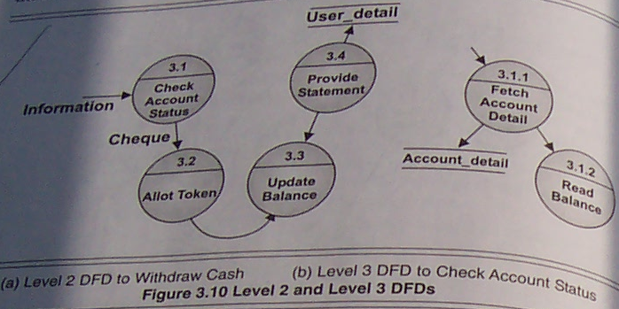
Nilina Bera

Slide 16
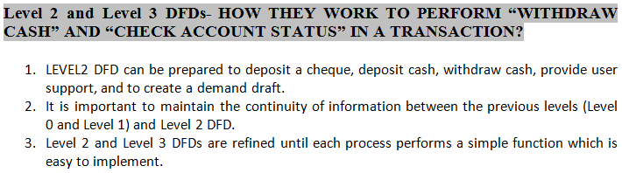
Nilina Bera

Slide 17
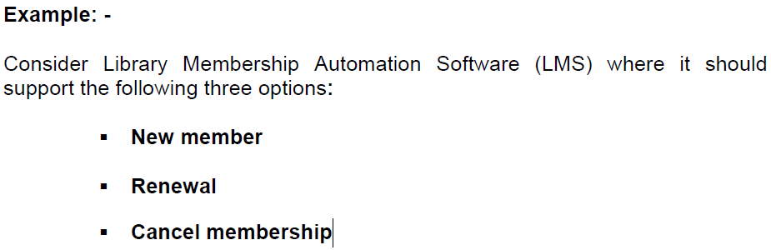
Decision tree
A decision tree gives a graphic view of the processing logic involved in decision making and the corresponding actions taken.
The edges of a decision tree represent conditions and the leaf nodes represent the actions to be performed depending on the outcome of testing the condition.
Nilina Bera

Slide 18
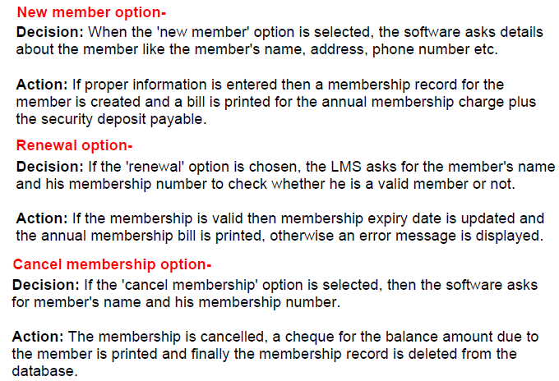
Decision tree
Nilina Bera

Slide 19
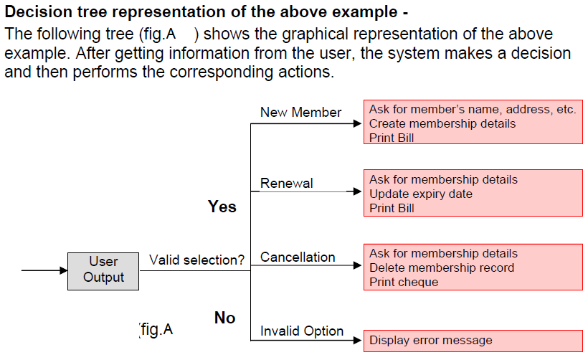
Nilina Bera

Slide 20
Decision Table
A decision table is used to represent the complex processing logic in a tabular or a matrix form.
The upper rows of the table specify the variables or conditions to be evaluated.
The lower rows of the table specify the actions to be taken when the corresponding conditions are satisfied.
A column in a table is called a rule.
A rule implies that if a condition is true, then the corresponding action is to be executed.
Nilina Bera

Slide 21
Decision Table : Example
Consider the previously discussed LMS example.
The following decision table (fig. B) shows how to represent the LMS problem in a tabular form.
Here the table is divided into two parts, the upper part shows the conditions and the lower part shows what actions are taken.
Each column of the table is a rule.
Nilina Bera

Slide 22
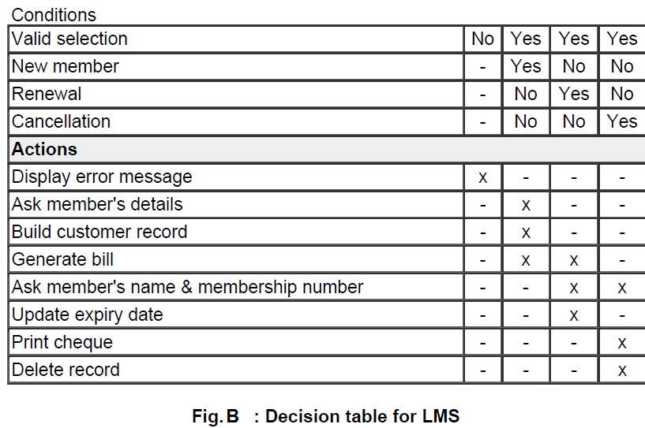
Nilina Bera

Slide 23
Decision Table : Example
From the above table you can easily understand that, if the valid selection condition is false then the action taken for this condition is 'display error message'.
Similarly, the actions taken for other conditions can be inferred from the table.
Nilina Bera

